Slide 1
Development of CAM systems for the Incremental Forming of CFRTP from 3D CAD data
Sophia University, Faculty of Science and Technology, Green Engineering Program
Precision Engineering Laboratory
A2177802 Karter Wong
Notes:
Hello. My name is Karter Wong, and I will present my research topic: the Development of CAM systems for the Incremental Forming of CFRTP from 3D CAD data.

Slide 2
Presentation content
Background Information
Previous Research
CAM System Changes
Research Progress
Future Plan
Notes:
Today, I will briefly review some background information, then previous research on this topic, the progress I have made since the last presentation, and the plan for the remaining part of the semester.

Slide 3
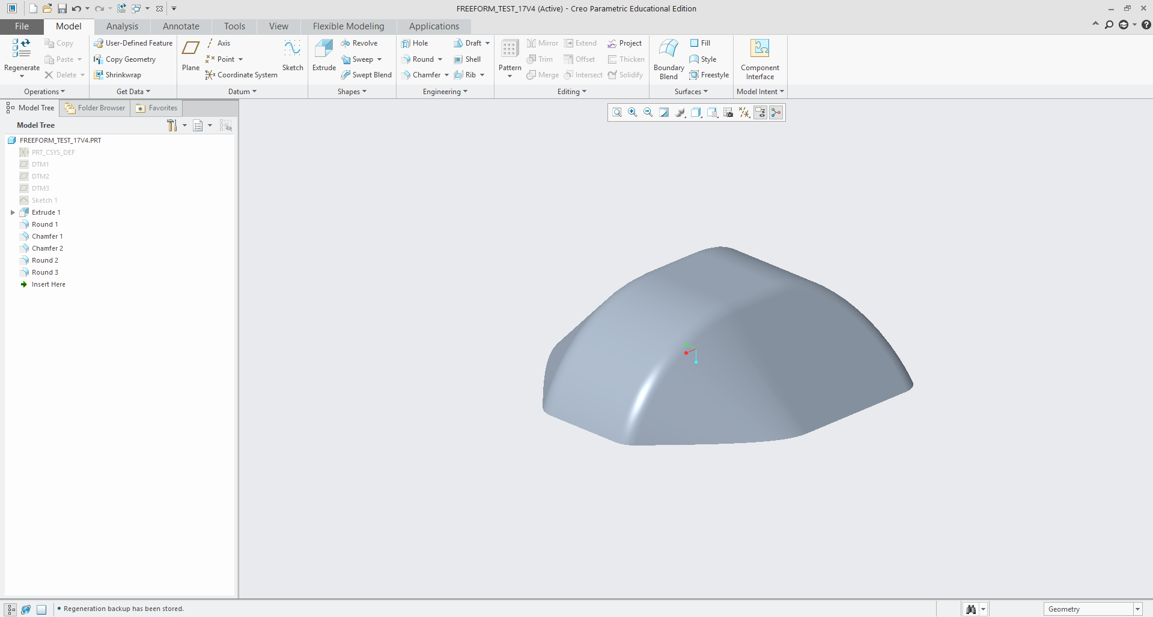
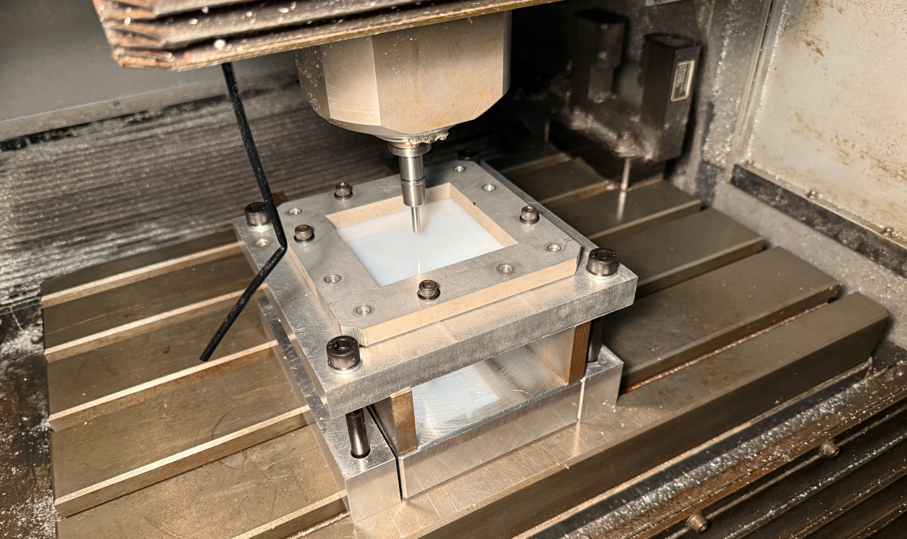
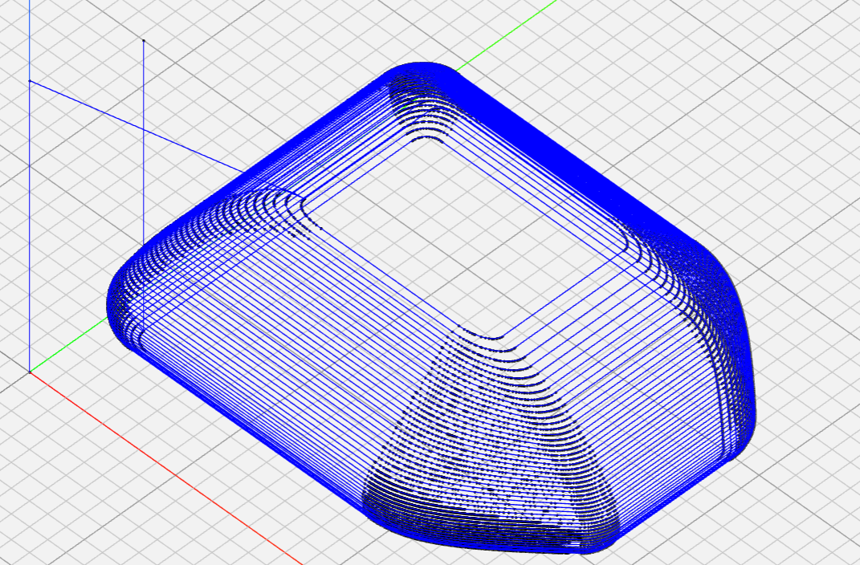
Background Information Incremental Forming
CAD
Forming
Tool Path
Notes:
Incremental forming
Incremental forming is a flexible forming process that can shape sheets of various materials using plastic deformation of the sheet with a tool into the desired shape.
Unlike traditional manufacturing processes, it does not require dies or molds, making it ideal for low-volume production, prototyping, or custom parts. The tool follows a programmed path to manufacture thin shell shapes, offering reduced setup and production costs.
It also allows production of various products in small quantities, where mold creation would be too expensive.

Slide 4
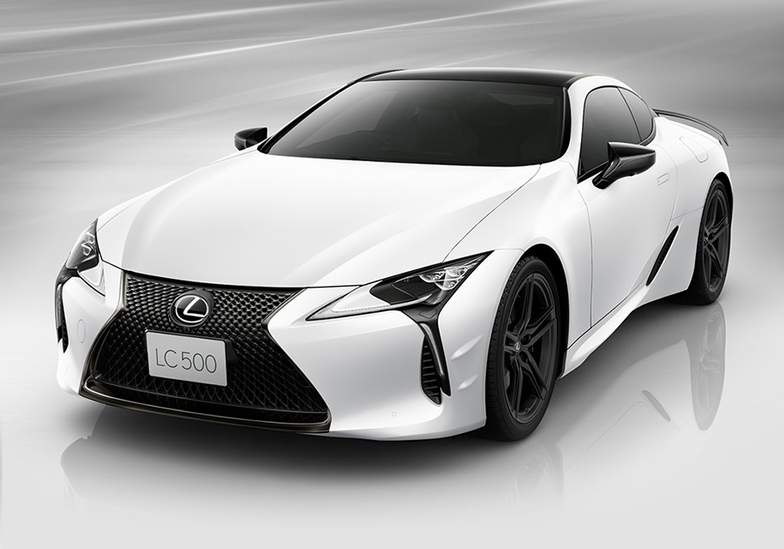
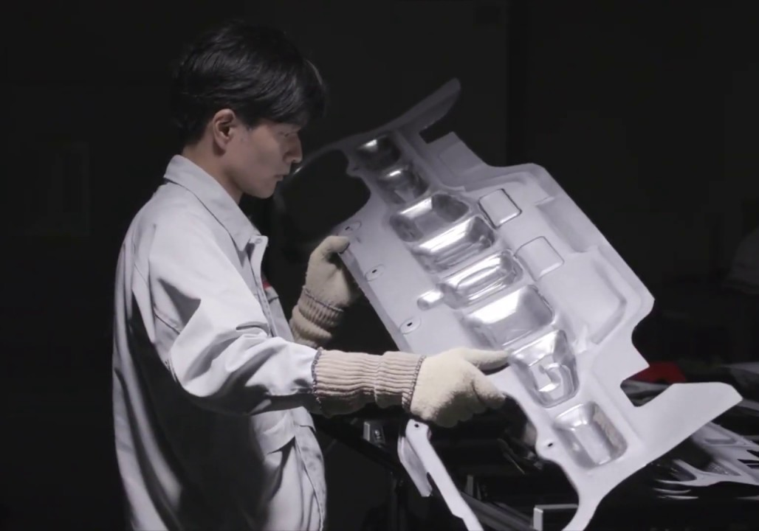
Background Information Incremental Forming
Lexus LS Edge
Nissan’s Incremental
Forming Showcase
Notes:
An example of Incremental forming in use today is by car manufacturers like Ford, Nissan, and Lexus. These manufacturers use incremental forming to prototype new vehicle designs and add minor customizations to vehicles, as seen on the Lexus LS edge, as shown in the red circle of the figure on the right.

Slide 5
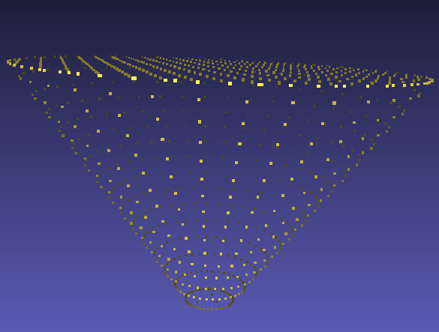
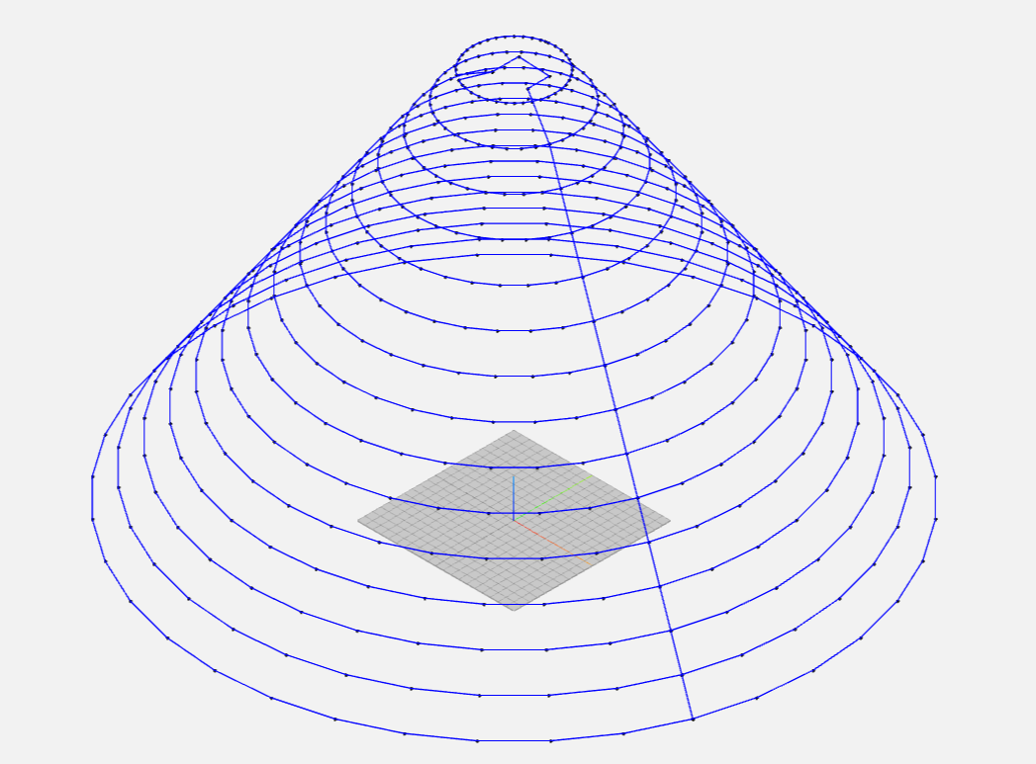
Previous Research
Point Cloud Formation
Tool Path Generation
G-Code
STL Data
Notes:
Previous research on this topic developed a simple CAM system to generate a tool path and conducted experiments to test the tool path. The experimental conditions of the experiments will be described later.
The CAM system developed during the previous research using Python can be described in four steps:
First, STL data from the 3D CAD data is converted into a point cloud, a collection of points from the triangles given by the STL file.
Next, the point cloud's points are grouped into layers defined by the Z coordinate. During this process, the program looks for the points on the outermost part of the figure so that the toolpath does not go in the middle of the forming shape.
The third step is to construct the toolpath, which is done by calculating the distances from the tool's current position to the other points on the layer and moving to the point with the shortest distance. This process is repeated for all the points on a layer and each layer.
The final step is to convert the X, Y, and Z coordinates into G-code so that the machine can read the generated tool path.

Slide 6
CAM System
Point Cloud Formation
Updated Tool Path Generation
G-Code
STL Data
Toolpath Adjustments
Points Sorting
Notes:
Using the previous research as a base, I have added some changes to the CAM system to work with complex shapes. These include the initial and ending commands needed for every toolpath, Convex hull, reverse offset, and other smaller features to make the program's transition from designing to machining smoother.
In the updated CAM system, instead of just loading the STL file as it is and forming the point cloud, the CAM system rounds all the Z coordinates to the nearest whole number. It then forms the point cloud but also sets a uniform layer distance of 1 mm and, like the other program, goes from the highest layer to the lowest.
Next, the CAM system finds the outer boundary of points using the convex hull library while removing layers with less than 5 points. Then, the points are filtered to remove points within a certain radius of the current point. Then, the CAM system sorts the points again so that the toolpath is smooth and the points are all "visited" by the tool once. Then, the program closes the layer by connecting the last point to the first point.
After generating the toolpath, the X, Y, and Z coordinates are rounded to increase the accuracy of the tool paths. The reverse offset is applied, shrinking the toolpath by the diameter of the tool.
Finally, the coordinates are converted to G-code by adding the proper syntax, initial setup commands like the spindle speed, feed rate, etc., and the program's termination sequence, which moves the toolpath to a safe height and stops the machine.
These changes allow the CAM system to generate a smooth toolpath for complex shapes, optimize the generation process, and allow the operator to start machining immediately after the toolpath is generated without any adjustments.

Slide 7
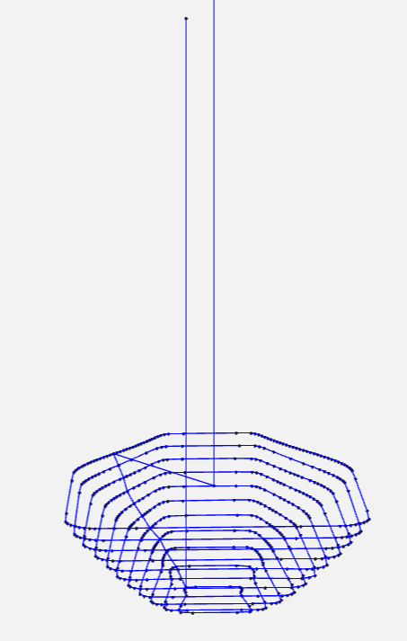
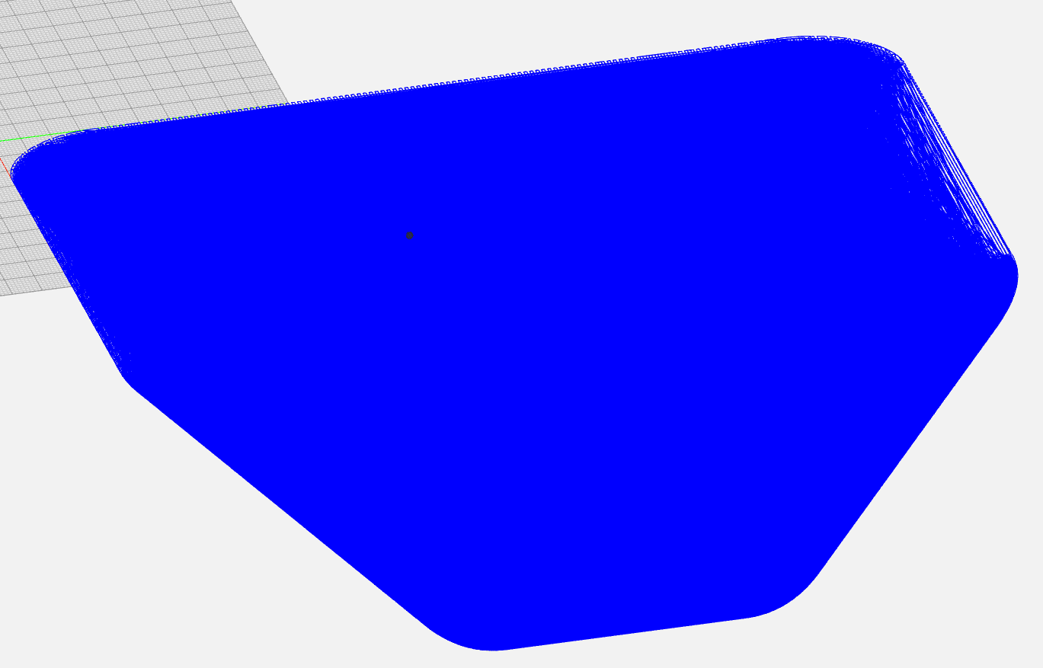
CAM System Comparison
Previous Research
CAM System
Updated CAM System
Notes:
Here is a comparison of the CAM system used in previous research and the updated CAM system for the current test shape, which is more complex than the previous research test shape, which was a truncated cone.
The updated CAM system produces a simplified tool path, as seen in the figure on the left. The Previous CAM system processed all the points from the point cloud, taking over an hour and a half to generate the toolpath versus the updated system's 2 seconds.

Slide 8
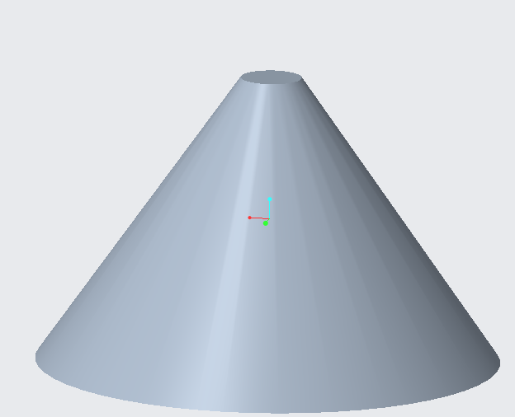
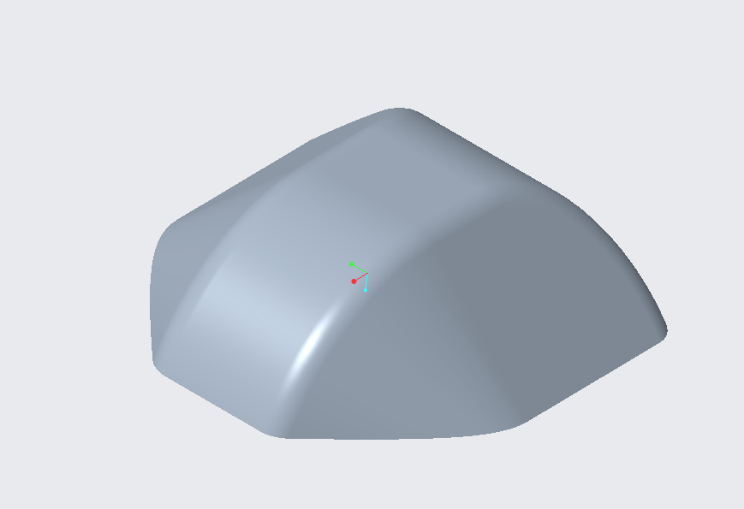
Research Progress Test Shape Change
Previous Research’s
Test Shape
Current Test Shape
Notes:
To test the capabilities of the CAM system, a more complex test shape was used instead of the previous research’s truncated cone.
The updated shape is a rectangular prism with chamfered and rounded edges; the dimensions of the current test shape are 30 mm x 30 mm x 9.9 mm. These dimensions of the figure were chosen to ensure the figure would not have any 90-degree angles while adding some complexity.

Slide 9
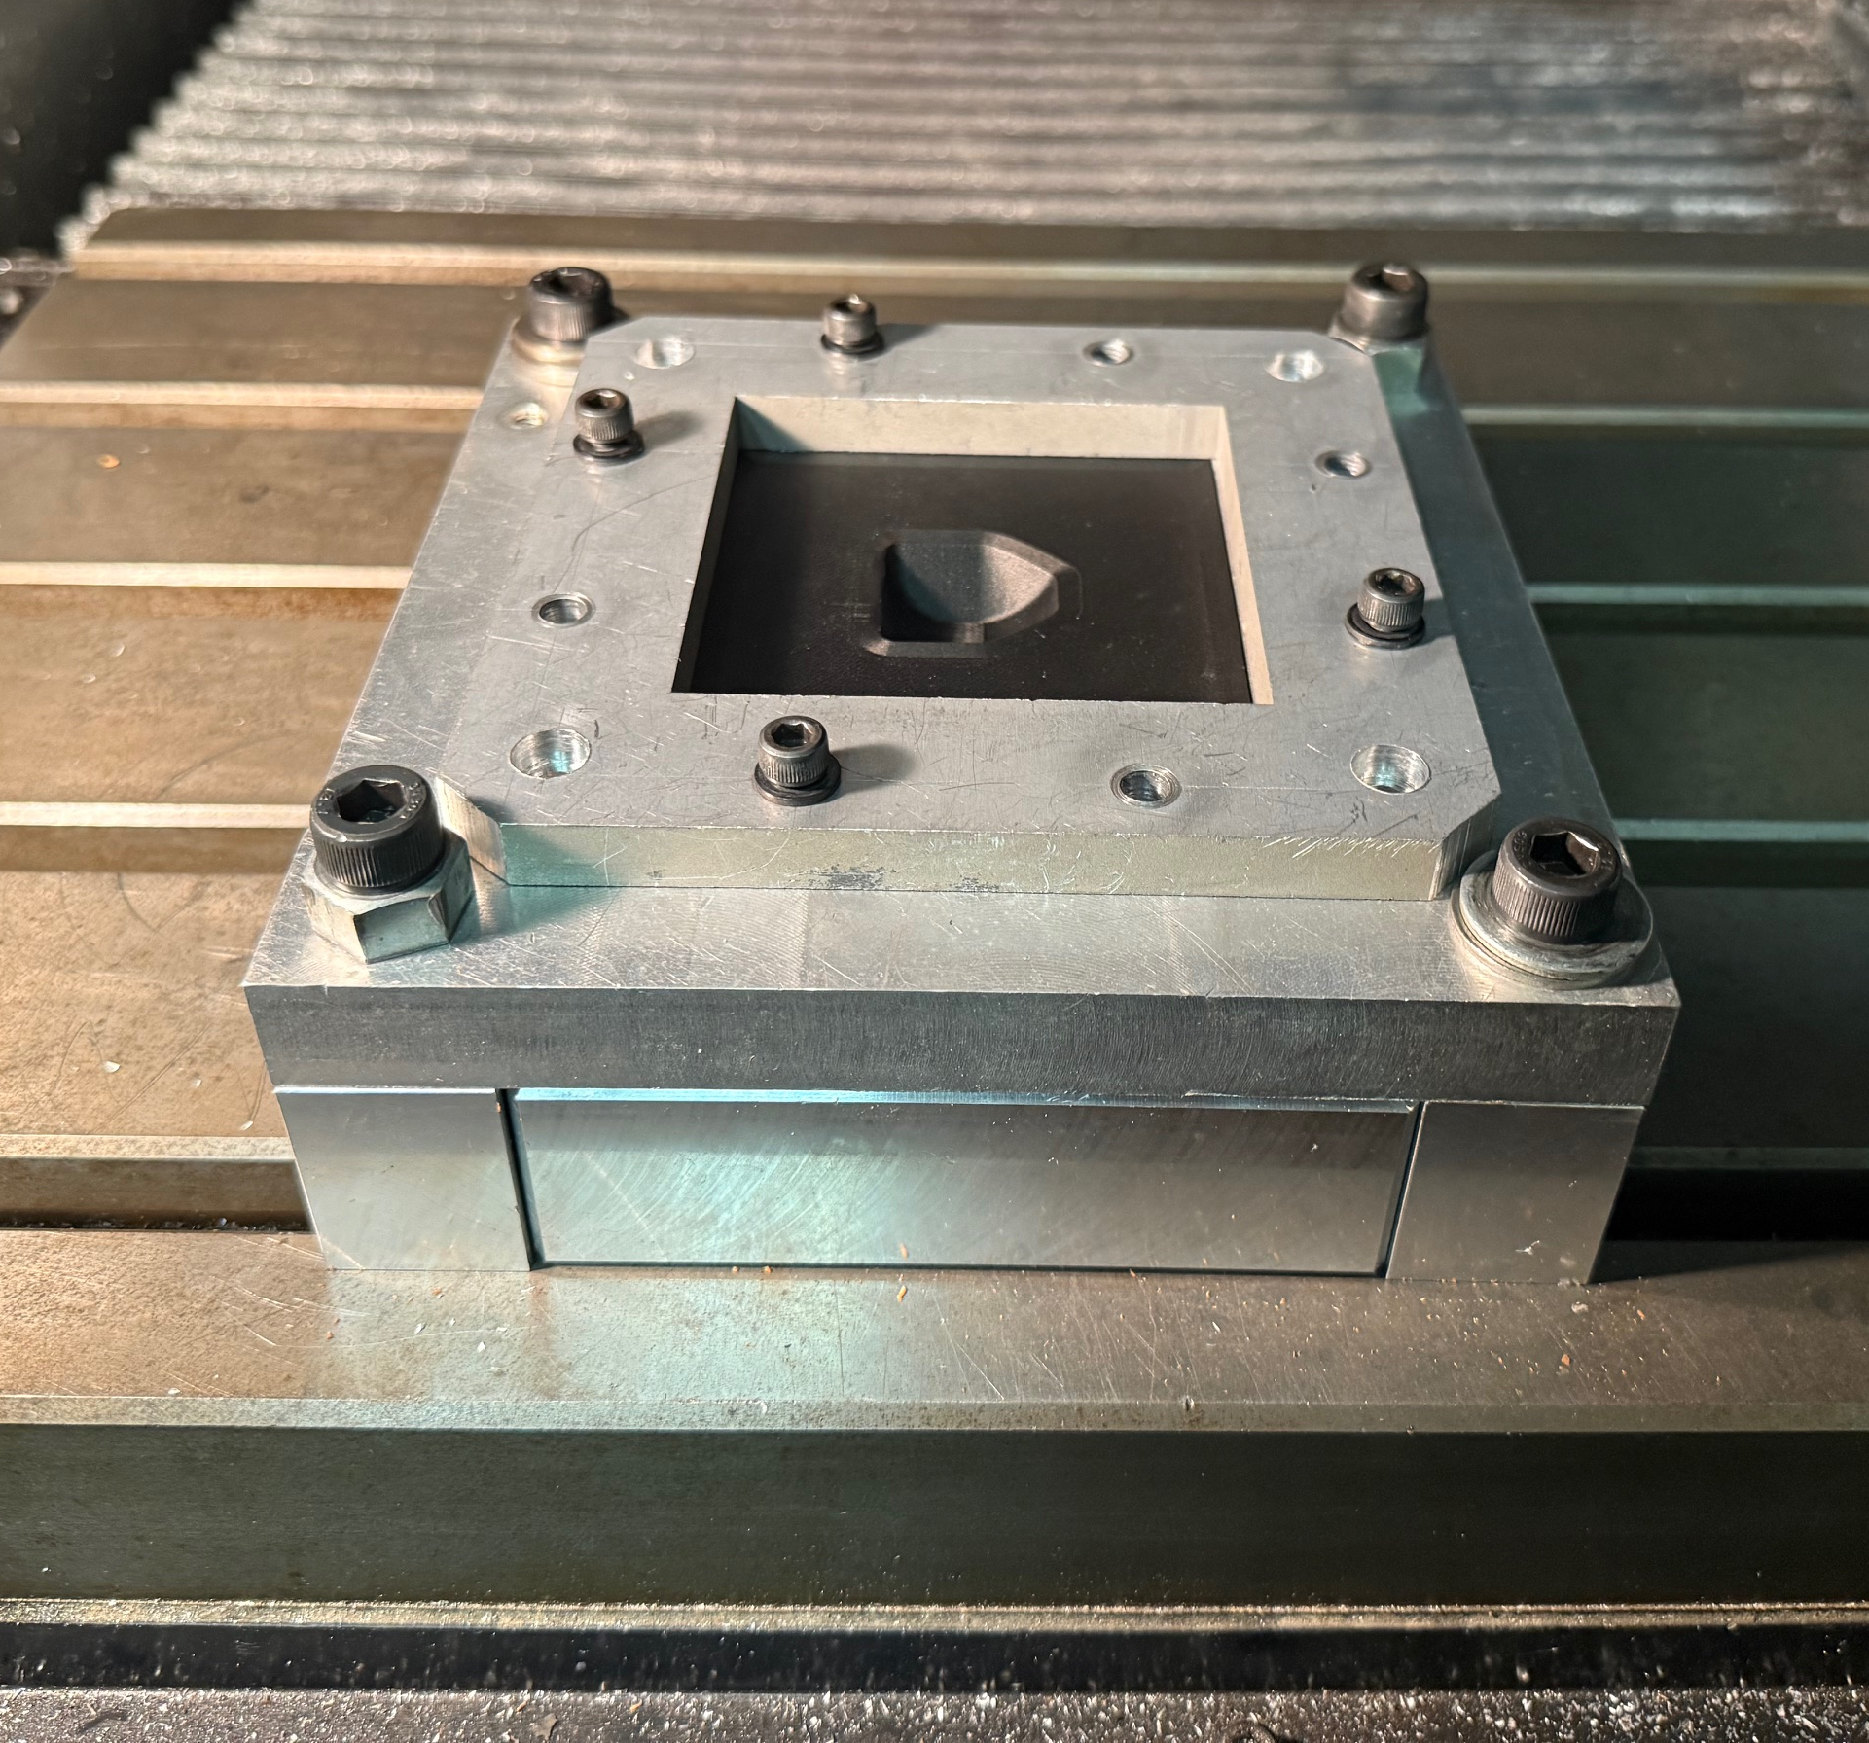
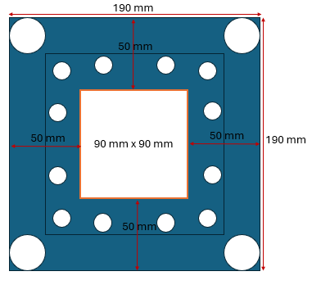
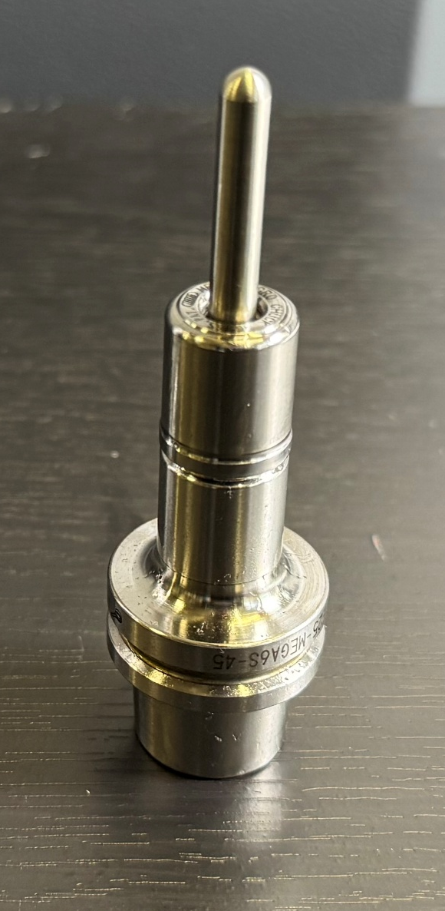
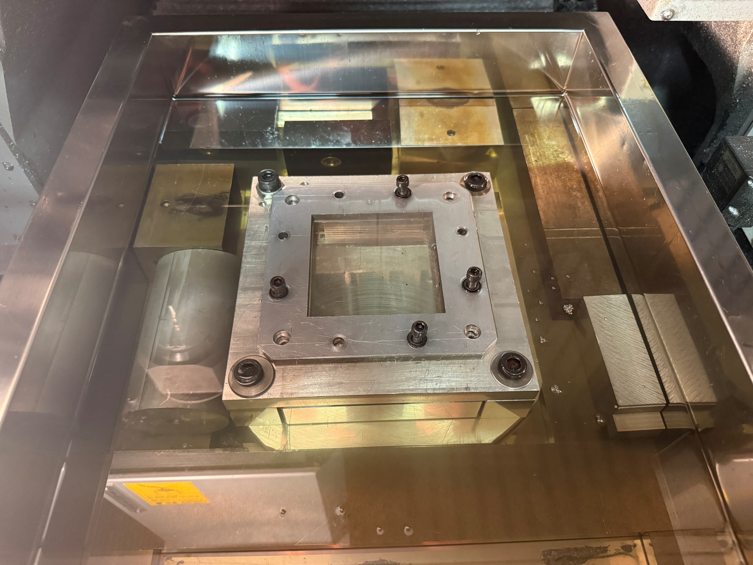
Experimental Equipment
Jig Dimensions
Notes:
To conduct the experiments, I used an MC430L machining center on nylon sheets that were about 110 mm x 110 mm x 1mm, with a mold of 89.92 mm x 89.92 mm x 20 mm of my test shape, which is 30 mm x 30 mm x 9.9 mm. The tool that was used is a 5 mm diameter rod as seen on the left hand side of the screen.

Slide 10
Experimental Results CFRTP Tests
Tests Without a Mold With CFRTP
Test Number | Feed Rate (mm/min) | Spindle Speed (RPM) | Temperature (Degrees C) | Forming depth (mm)
1 | 1000 | 500 | 150 | 9.85
Tests With a Mold with CFRTP
Test Number | Feed Rate (mm/min) | Spindle Speed (RPM) | Temperature (Degrees C) | Forming depth (mm)
1 | 400 | 400 | 120 | 9.96
2 | 1000 | 500 | 120 | 8.75
3 | 1000 | 500 | 150 | 10.80
Notes:
Since the last presentation, I have done four experiments with CFRTP with the experimental conditions and results as shown on the slide. The tests at 120 degrees Celsius both had defects and rough surfaces due to being taken out of the oil bath prematurely. The tests at 150 degrees C were both successful in forming the test shape and reached depths that were near the target depth. Due to issues with the 3D scanner, I could not accurately analyze the results from these tests.

Slide 11
Conclusion and Next Steps
Potential Improvements:
CAM System Optimization
Setup Improvements
Cycle Time Reduction
Analysis Enhancements
Notes:
This study successfully improved the previous CAM system for static incremental forming of discontinuous CFRTP. The updated system addressed several limitations the prior CAM system had, solving three issues: generating precise, error-free toolpaths for complex geometries, significantly reducing toolpath generation time for complex geometries, and streamlining the design-to-manufacturing process.
However, there is still room for improvement with the CAM system and the way we conduct incremental forming with the oil bath.
First, further optimizations and user friendly features can be added to further streamline the process for first time users. Things like a way for the CAM system to Implement automatic detection of workpiece origin so that the setup process can be sped up. Currently, manual origin setting for machine and jig slows experiment cycles.
A change that could be made to the overall process of the experiments is to research methods to cool the oil bath down quicker so that multiple tests could be conducted in one day.
Also finding a 3D scanner that would be able to accurately scan the formed workpiece so that better analysis on the effects of the CAM system can be done.

Slide 12
Thank You For Listening
Notes:
Thank you for listening. Do you have any questions?

Slide 14
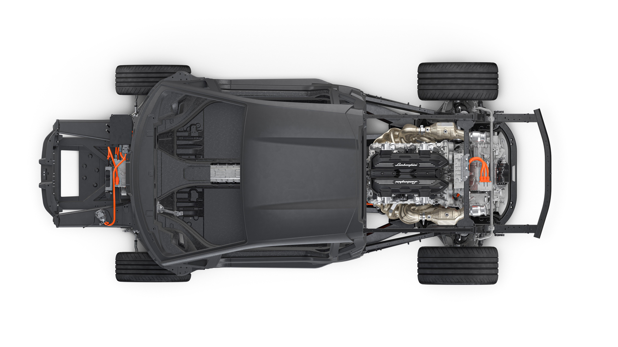
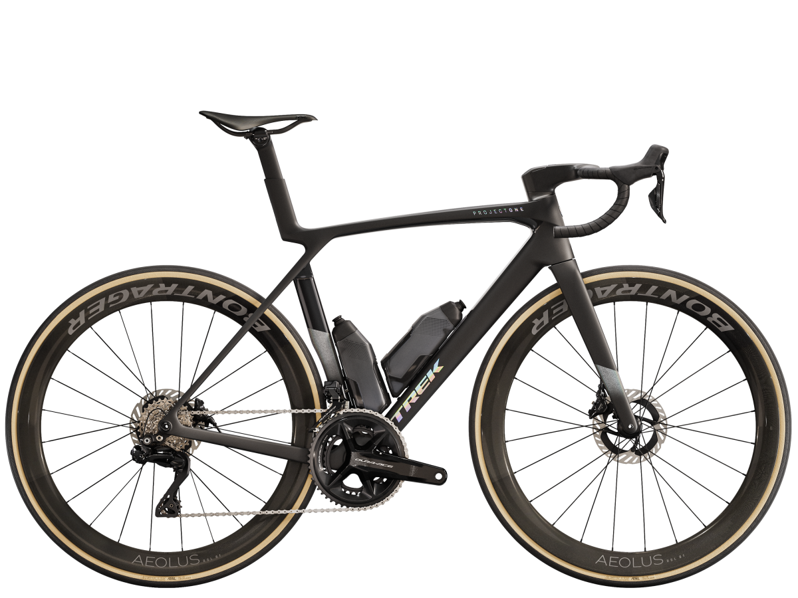
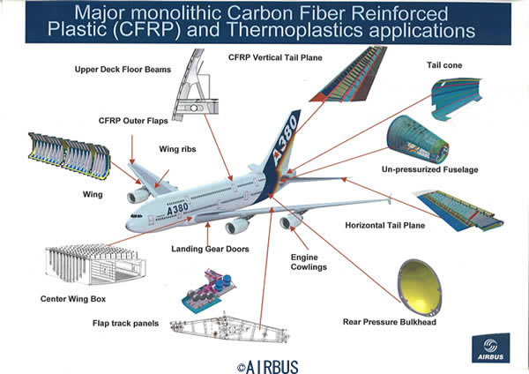
Background Information Additional information
Carbon Fiber Reinforced Thermoplastic (CFRTP)
Lamborghini Aventador CFTP parts
Notes:
Carbon Fiber Reinforced Thermoplastic (CFRTP) is a composite material that combines carbon fiber with a thermoplastic matrix, offering a high strength-to-weight ratio, durability, and recyclability compared to thermoset composites. It can be easily reshaped when heated, simplifying manufacturing and facilitating repairs, making it an ideal material for various industries where weight reduction, material strength and high upkeep is necessary. In industries like the automotive industry with the Lamborghini Aventador where carbon fiber is used in the frame of the vehicle, the aerospace industry where planes like the Airbus A380 uses CFRTP for various parts like the wings and the vertical tail wing. Trek's Madone bike frames leverage CFRTP for stiffness and reduced weight for sports equipment.

Slide 15
Add python code here
Add any other figures needed.

Slide 16

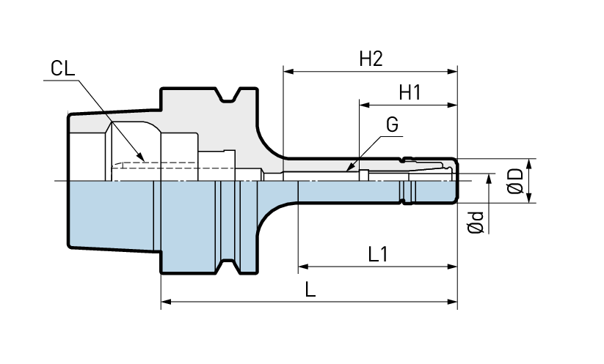
Research Progress Experimental equipment
Mega Micro type S Chuck
Ød : | 0.45 - 6.05
ØD: | 14 mm
L: | 45
L1: | 32
G: | -
H1: | 28
H2: | 31

Slide 17
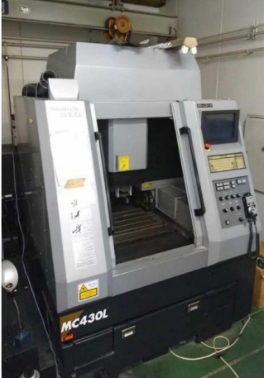
Research Progress Experimental equipment
MC430L machining center

Slide 18
Issues with previous research CAM system
Suboptimal Paths: The method uses a greedy nearest-neighbor heuristic, which often produces suboptimal paths. For TSP, this can result in significantly longer total path lengths compared to optimal or near-optimal solutions, increasing machining time and energy use in incremental forming.
Lack of Optimization: It doesn’t consider global optimization techniques (e.g., dynamic programming, branch-and-bound, or metaheuristics like simulated annealing), which TSP libraries employ to find better solutions.
Code Complexity and Maintenance: The code is complex, with manual handling of arrays, loops, and file I/O (e.g., saving and loading layer.csv). This increases the risk of bugs and makes it harder to maintain or extend compared to a library’s streamlined API.
Scalability Issues: For large point clouds (common in incremental forming), the iterative distance calculations and array manipulations (e.g., np.linalg.norm, np.delete) are computationally inefficient, leading to slow performance.
Limited Flexibility: The method is tailored to a specific point cloud structure and doesn’t easily adapt to variations like weighted graphs, constraints (e.g., toolpath continuity), or alternative distance metrics.

Slide 19
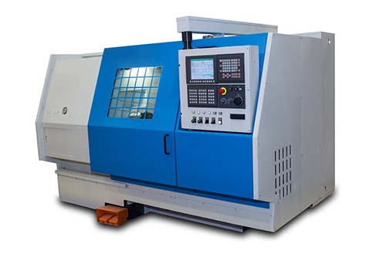

Background Information
What is CAD and CAM
CAD (Computer Aided Design)
CAM (Computer Aided Machining)
CAD
CAM
Notes:
What are CAD and CAM systems?
CAD and CAM systems are different technologies used for product design and manufacturing.
CAD software creates, modifies, analyzes, and optimizes 2D or 3D digital models of physical objects. Engineers and designers can visualize designs, perform simulations, and generate precise technical drawings. Some examples of CAD software are Creo and Fusion 360.
CAM systems are software that uses CAD models to control and automate manufacturing processes, such as CNC machining, and 3D printing. The software generates tool paths and instructions for machines to produce parts efficiently and precisely.
(Computer Numerical Control)

Slide 20
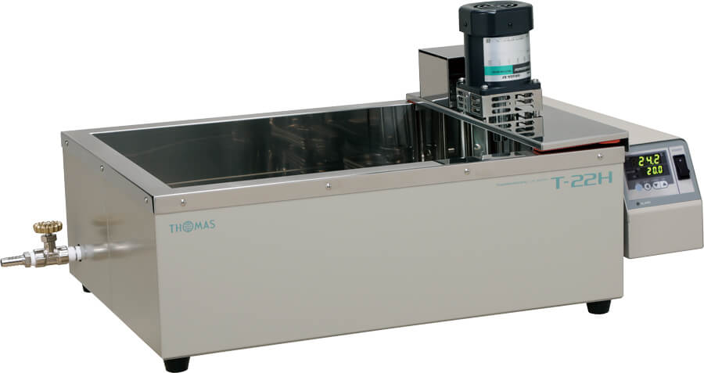
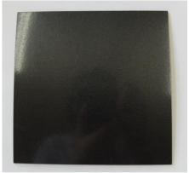
Future Plan CFRTP Tests
T -22H Oil Bath
CFRTP Test Piece
Notes:
Between now and the next presentation, my goal is to conduct experiments with CRTP in an oil bath with and without the mold. I will also learn how to use the 3D scanner to analyze the results, as right now, it is hard to determine accurately if the test piece was formed to the correct specifications.
After this, I will attempt to improve the formability of the test shape.
The experimental equipment will be the same as that used in previous research. The T -22H oil bath and silicon oil will be used to heat the CFRTP for forming.
The test piece will be a sheet of CFRTP that is 110 mm × 110 mm thick and 1 mm thick.

Slide 21
Future Plan
Previous Research Experimental Conditions:
Angle: | 40°
Feed Rate: | 1000 mm/min
Test Shape Radius: | 20 mm
Pitch: | 1 mm
Depth: | 15 mm
Temperature: | 393K (120°C)
Spindle rotation: | 1000 rpm
Experimental Conditions for the Following Experiments:
Angle: | 45°
Feed Rate: | 1000 mm/min
Test Shape Dimensions: | 30 mm x 30 mm
Pitch: | 1 mm
Depth: | 9.9 mm
Temperature: | 393K (120°C)
Spindle rotation: | 1000 rpm
Notes:
The experimental conditions used for the oil testing will be based on the previous research's experimental conditions for the experiment that had the best results, as shown in the table on the right. The feed rate, spindle rotation, pitch, and temperature will be the same, while the other conditions will differ as the test shape is different.

